Slide 1
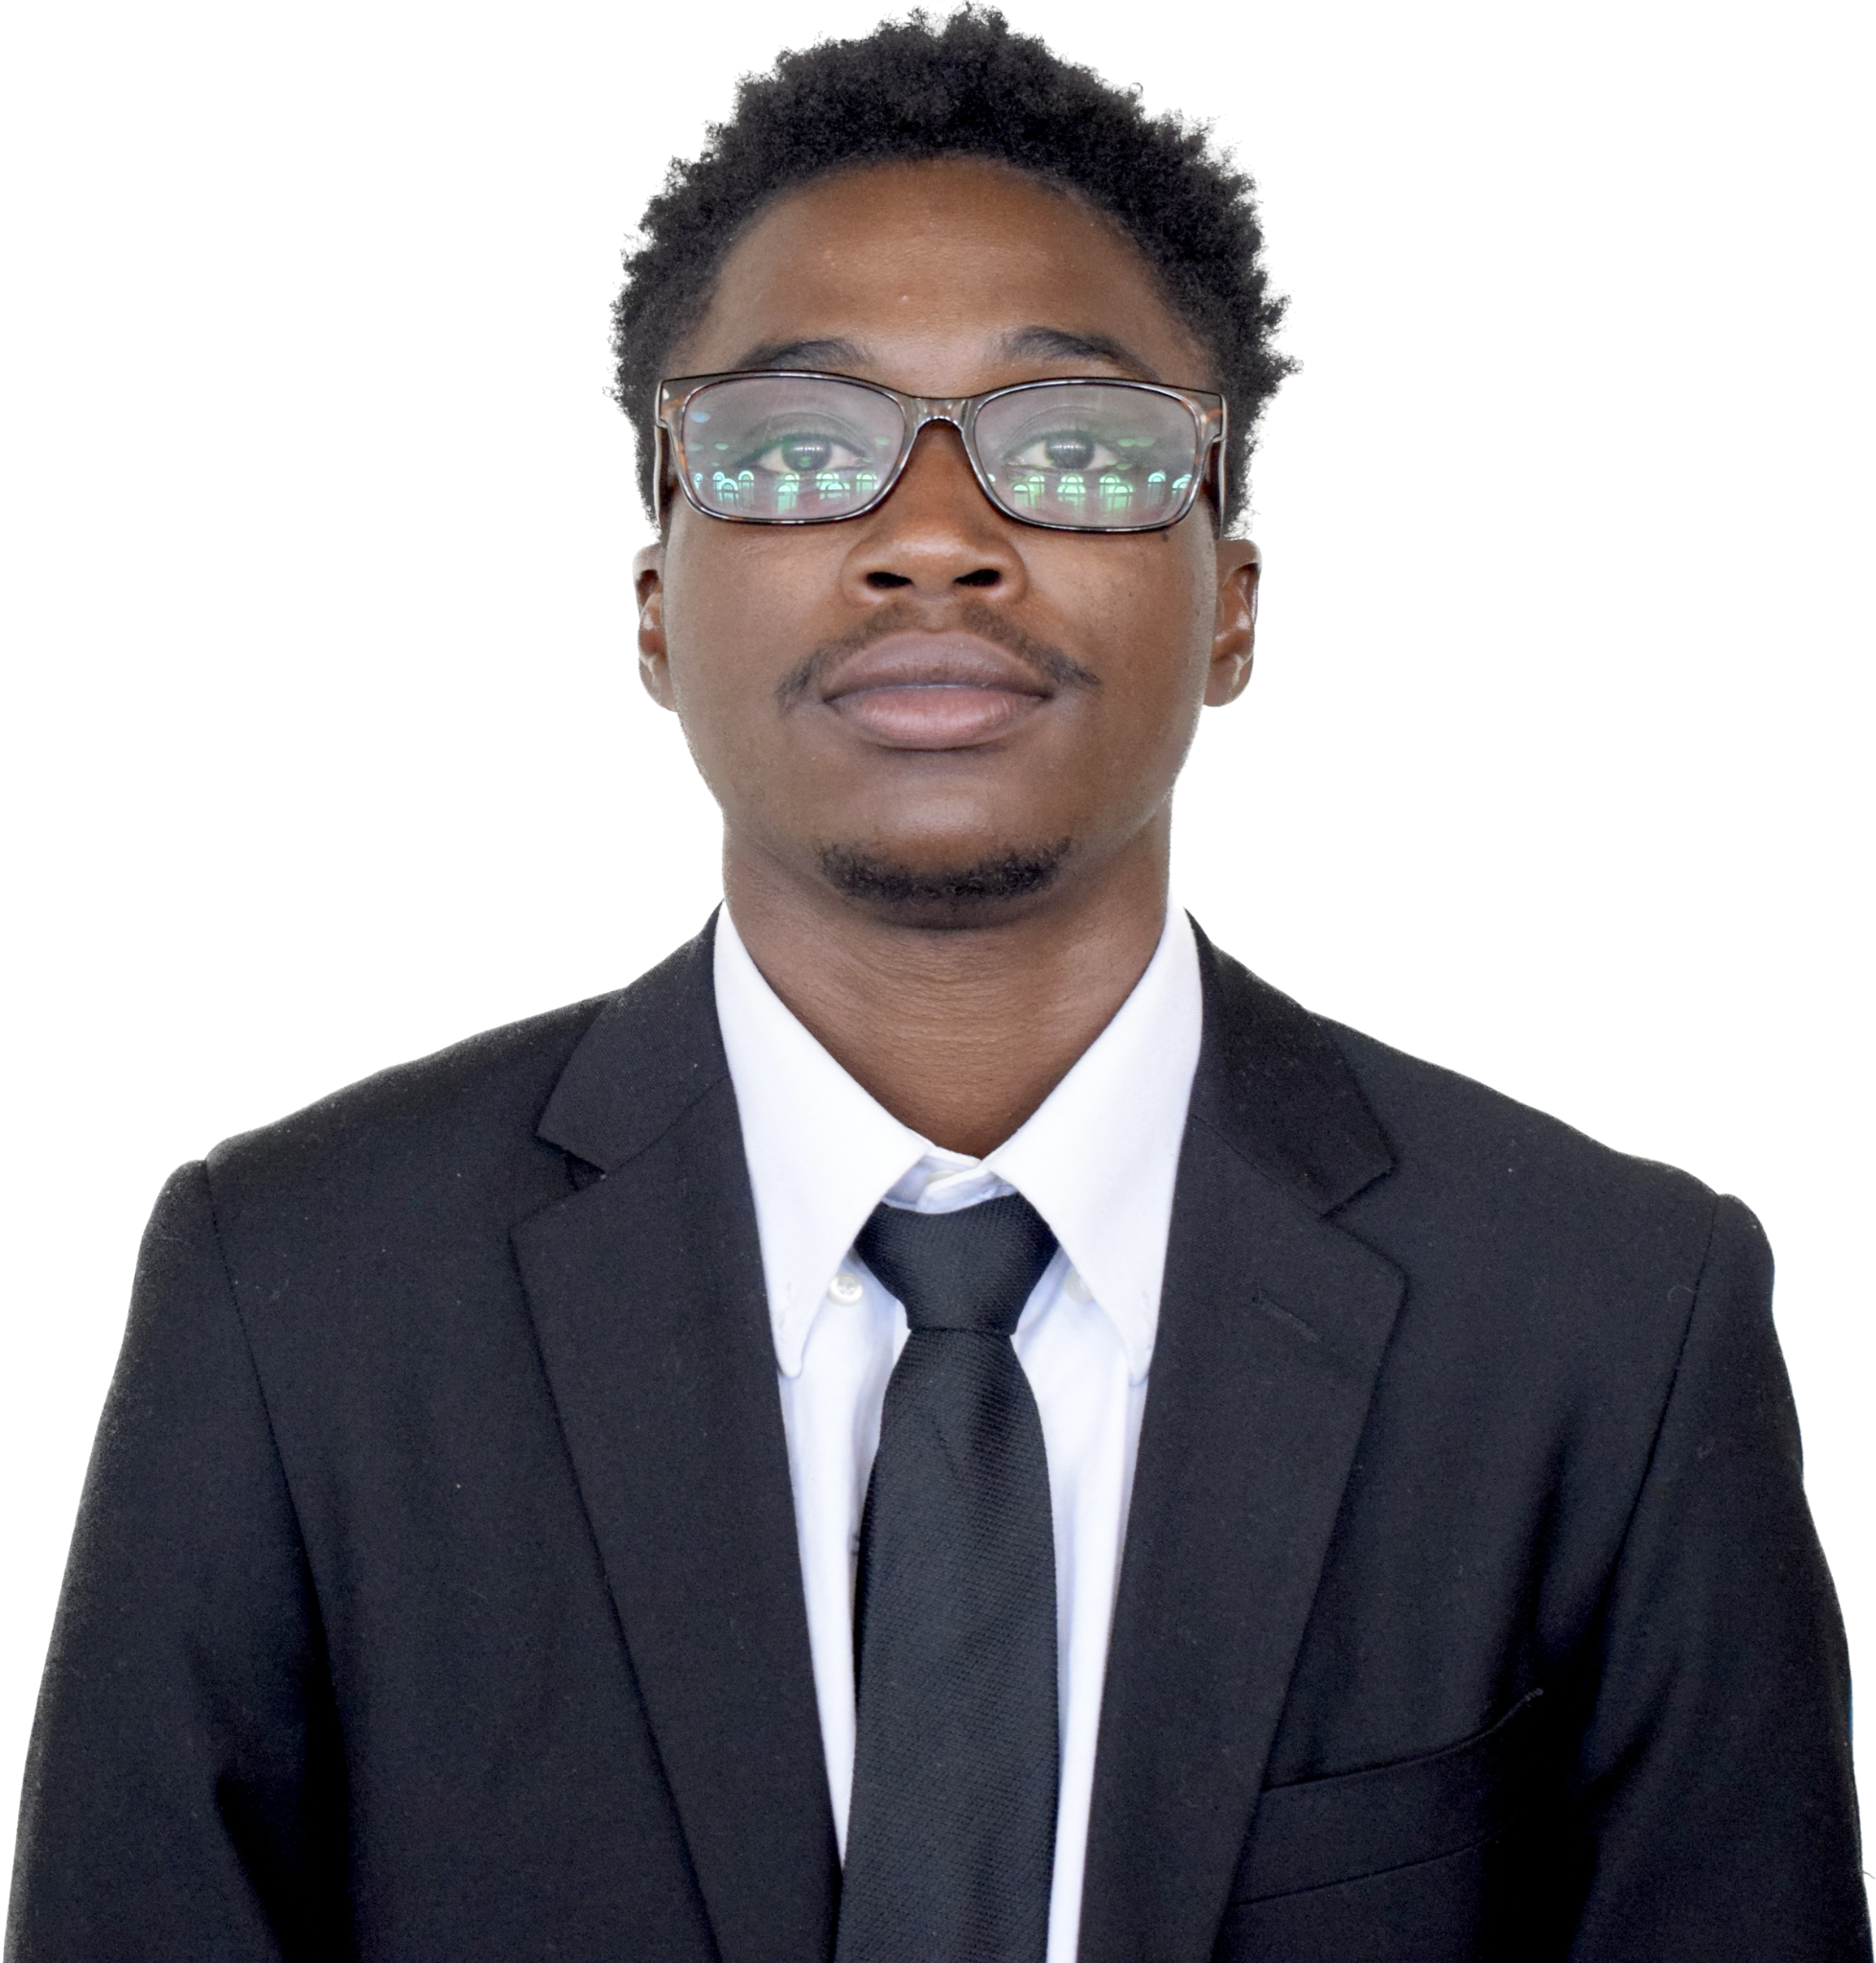
Terrie Vail
Senior Information Technology Scholar at Florida Agricultural & Mechanical University

Slide 2
Table of Contents
Education & Work Life…………… (Slide 3)
Brief Course History Run Down…………… (Slide 4)
Chapter Website (Project)............... (Slide 5)
Internship Experience…………… (Slide 6)
Passion For Technology…………… (Slide 7)
Future Aspirations Post - Graduate…………… (Slide 8)
End…………………… (Slide 9)

Slide 3


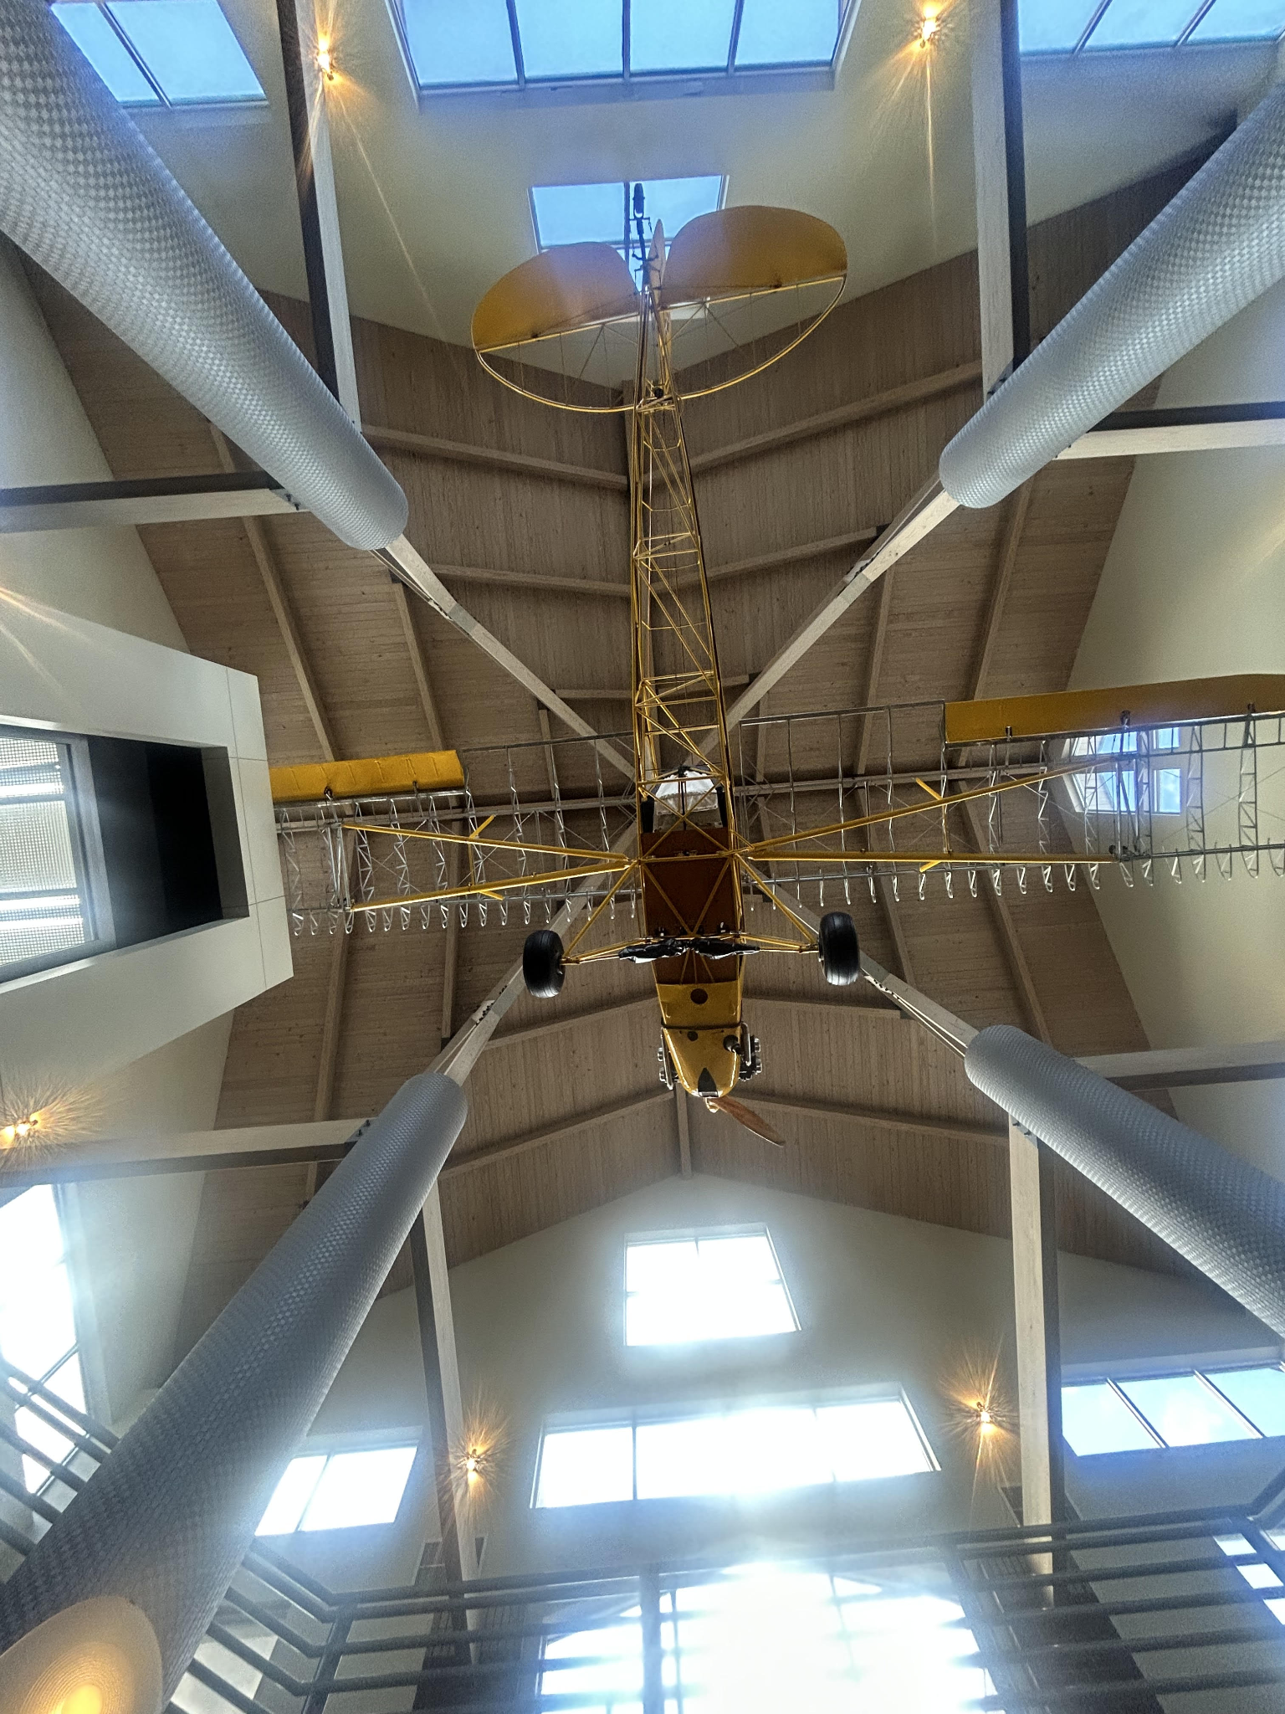
Education & Work Life
Rising Senior Information Technology Scholar at Florida Agricultural & Mechanical University` Concentration: Data Mining & Cybersecurity
(Expected Graduation: Fall 2025)
Vice President of The Gamma Chi Chapter Of Iota Phi Theta Fraternity Incorporated
Currently Employed at Silver Airways as a Cross Utilized Agent April 2024 - Present

Slide 4
Education & Work Life
Course History
Web Design| Fundamentals of Programming (C++)|Intro to C#| Computer and Human Interaction|Computer & Network System Admin|Database management|Intro to Computer Security
Skills Prepared: Cataloging Documents, SCRUM Foundations, Data Entry And Management, Microsoft Products(Excel,Powerpoint,Word), Networking, Communication, Teamwork, Microsoft Dynamics

Slide 5
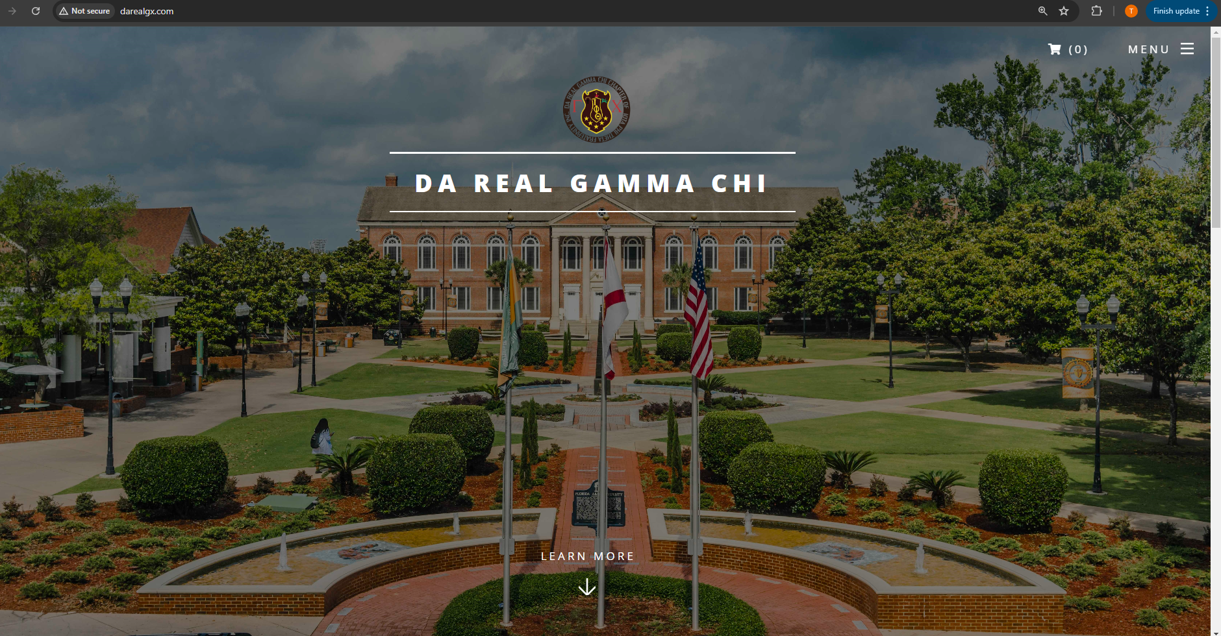
Chapter Website Development
Implement and optimize back-end processes with C++ and enhance front-end functionality with JavaScript, resulting in a comprehensive platform that serves over 55 active users, both brothers and non-brothers.
Enhance the user experience of the fraternity chapter website by designing intuitive and user-friendly interfaces using C++ and JavaScript. Regularly communicate with brothers through monthly emails, providing updates and information about website improvements and features.

Slide 6

Internship Experience
Summer 2024 Internship - Service Technician Intern - (Hybrid) - Tallahassee, Florida
Managed and responded to 50+ customer emails daily (VIA WIX) , addressing technical issues, processing service requests, and providing detailed solutions to enhance customer satisfaction.
Efficiently handled the intake and processing of client devices per day, ensuring accurate tracking and handling throughout the service process.
Processed 100-150 transactions daily (both cash and digital) with precision and accuracy, providing efficient and friendly service to customers.

Slide 7
Passion For Technology
Technology is a transformative phenomenon reshaping how we live and work, with the Internet of Things (IoT) and cloud computing playing pivotal roles in this evolution. IoT connects everyday devices to the internet, enabling real-time data collection and interaction across various fields, from smart homes to industrial automation. This interconnectedness drives efficiency, predictive maintenance, and seamless experiences. Meanwhile, cloud computing provides scalable, on-demand access to vast computing resources, allowing businesses and individuals to store, process, and analyze data remotely. Together, IoT and the cloud create a powerful synergy, where data generated by IoT devices is stored and managed in the cloud, driving smarter solutions and more informed decision-making across industries.

Slide 8
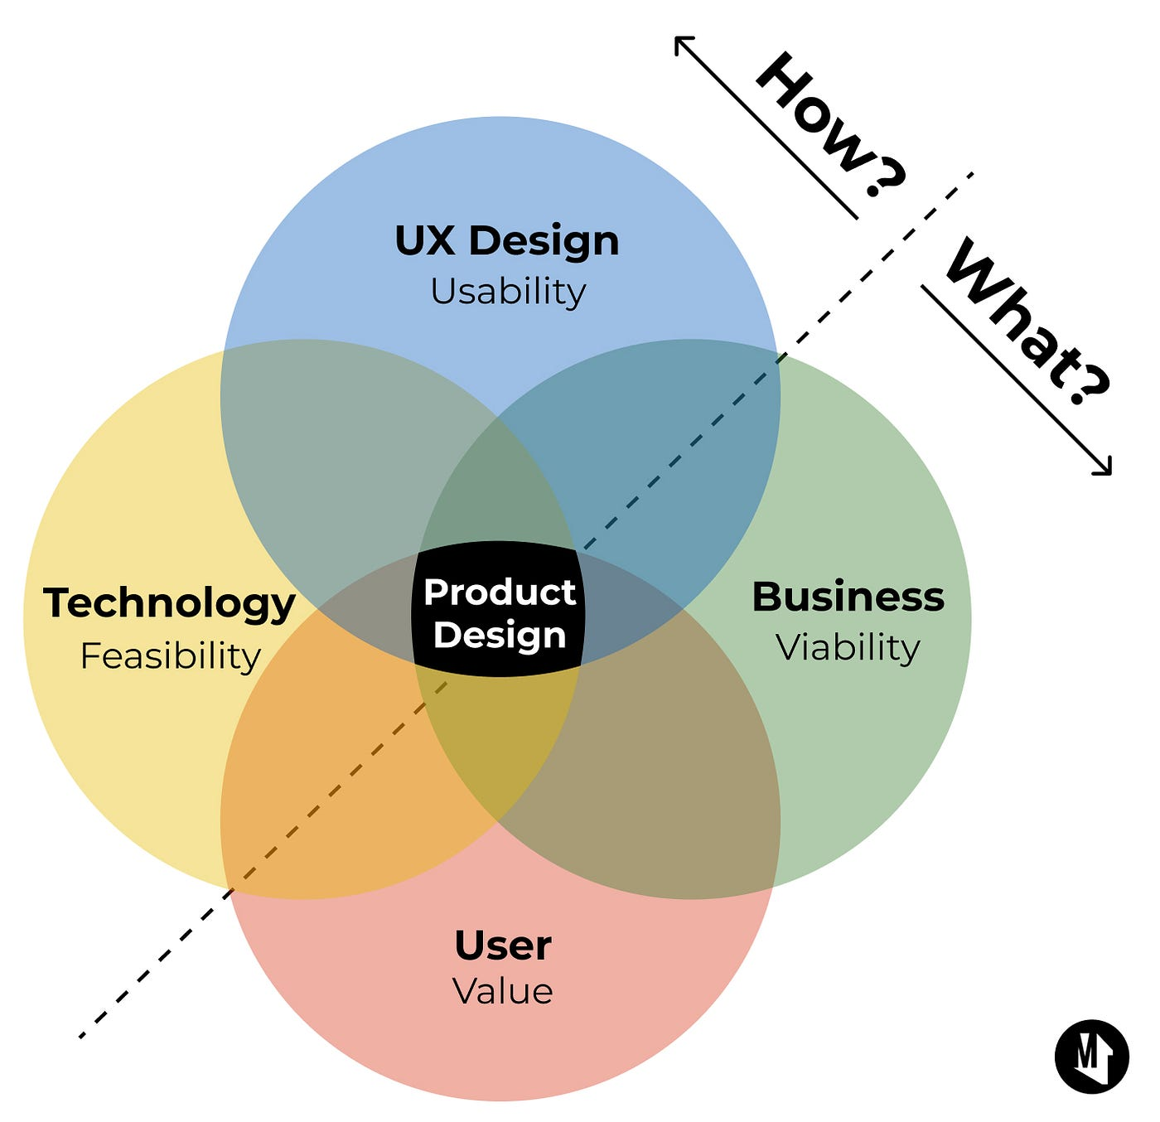

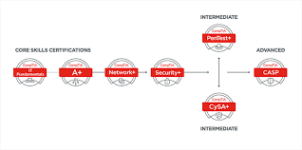

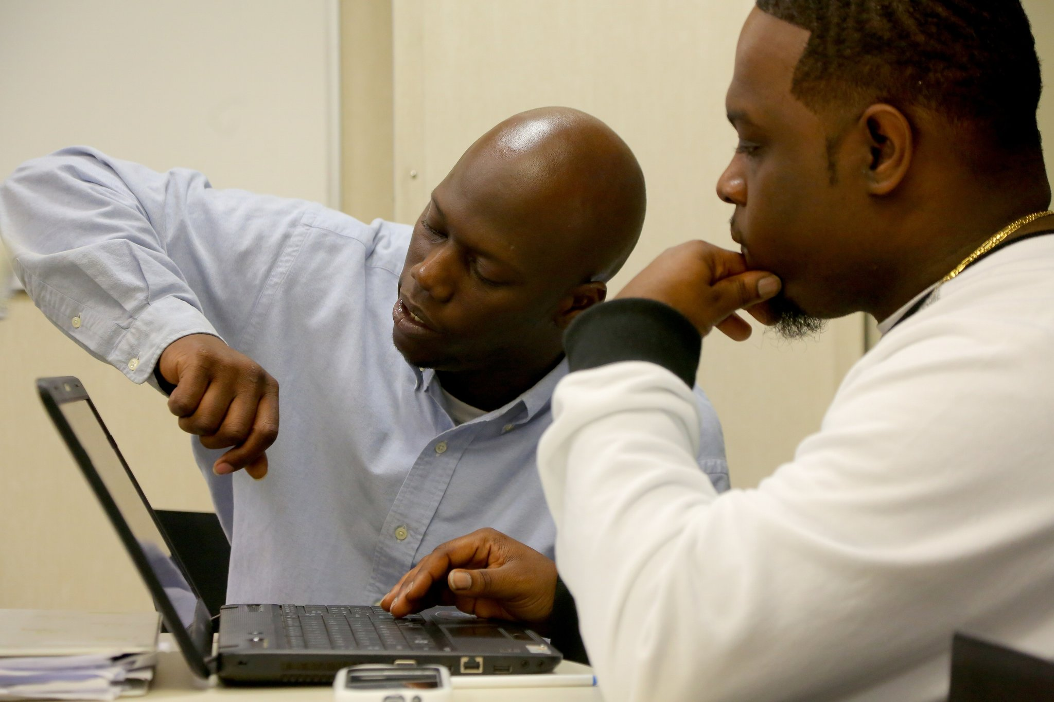
Future Aspirations Post - Graduate
Discipline
Mentorship
Time Management
Networking

Slide 9
The End
Thank you!!

